Slide 1
Tutorial 7 Linked lists
Jiawei Li (Michael)
Office hours: Monday 1:00-3:00pm
Office: PMB426
Email: jiawei.li@nottingham.edu.cn

Slide 2
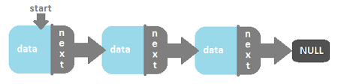
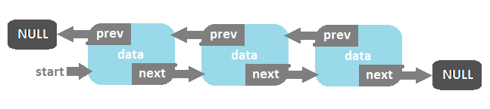
Singly linked lists
Doubly linked lists

Slide 3
Create a list
node1
start
temp
node2
node3
Stack
heap

Slide 4
Remove a node
heap
node1
Stack
start
node2
node3
ListNode *temp = currentPtr;
previousPtr->nextPtr = currentPtr->nextPtr;
free(temp);

Slide 5
Lists
struct listnode {
int ID;
char name[20];
struct listnode *nextPtr;
};
typedef struct listnode Listnode;
typedef Listnode *ListNodePtr;
int main(void)
{
ListNodePtr start = NULL;
…
insert(&start, value, string);
…
}
Global
Local

Slide 6
Global and local variables
#include <stdio.h>
void func1(void);
void func2(void);
int a;
int main(void)
{
a = 1;
func1();
printf(“%d\n”, a);
func2();
printf(“%d\n”, a);
return 0;
}
void func1(void)
{
int a = 2;
a++;
}
void func2(void)
{
a++;
}

Slide 7
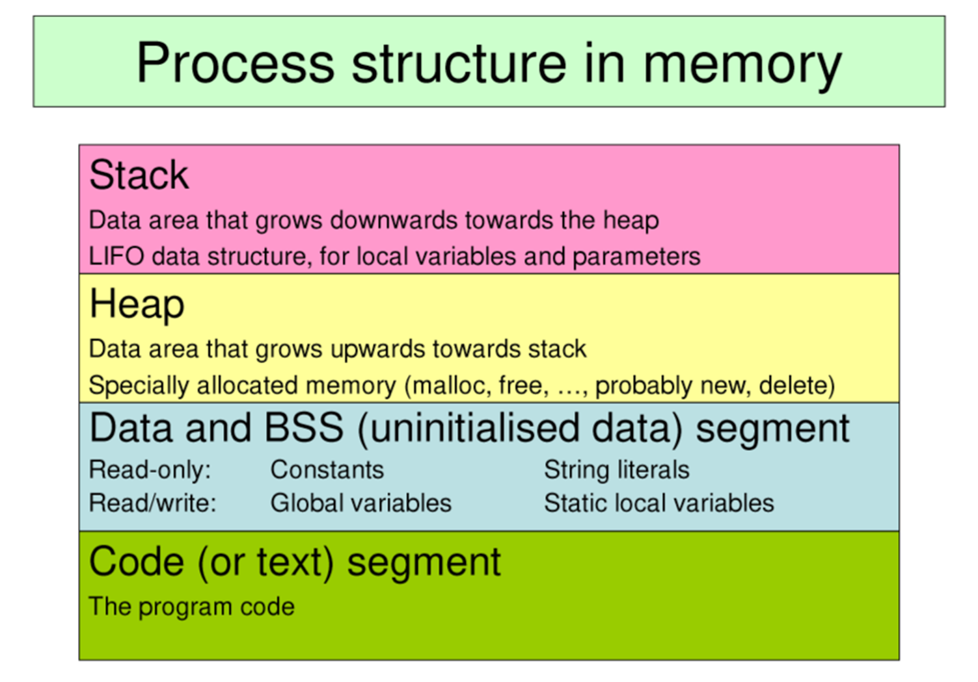

Slide 8
Lists
int main(void)
{
ListNode *start = NULL;
…
insert(&start, 1, “Paul”);
…
delete(&start, 2, “Michael”);
}
void insert(ListNode **sPtr, int value, char *string)
{
…
}
int delete(ListNode **sPtr, int value, char *string)
{
…
}
struct listnode {
int ID;
char name[20];
struct listnode *nextPtr;
};
typedef struct listnode Listnode;
//list of prototypes of functions
void insert(ListNode **sPtr, int value, char *string);
int delete(ListNode **sPtr, int value, char *string);
…
…

Slide 9
void insert_element(ipalist_t **start, int val)
{
if(*start == NULL)
{
ipalist_t *n = malloc(sizeof(ipalist_t));
n->value = val;
n->next = NULL;
*start = n;
}
else
{
ipalist_t *cur = *start;
while(cur->next != NULL)
{
cur = cur->next;
}
ipalist_t *n = malloc(sizeof(ipalist_t));
n->value = val;
n->next = NULL;
cur->next = n;
}
}
// This means that the list is empty
// Create the first node. The address of this node is extremely important!!!
// The list is not empty, so we add in a new node
// Create a copy of *start because we do not want to make any change to *start. Why?

Slide 10
Frequent mistakes
Type of data does matter.
Do we have to use pointers to pointers?
How to create the first node?
Remove a node or remove the list?
struct student_list
{
int ID;
char name[20];
int *next;
}; // Anything wrong in the code?

Slide 11
Frequent mistakes
struct student_list* LinkedList()
{
struct node *root;
struct node *conductor;
root = malloc(sizeof(struct root));
…
} // Anything wrong in the code?
void list_print(student_list** head)
{
while(*head!=NULL)
{
printf(“%d”, *head->ID);
*head = (*head)->next;
}
} // Anything wrong in the code?

Slide 12
Exercise for you
A program with the name of list.c is available on the Moodle. It allows the user to create a simple char list.
Your task is to write a function reverseList() which creates a new list that contains all the nodes of the original list in reverse order. For example, if the original list contains “a f f g k”, the new list should be “k g f f a”.
Declaration of the function is:
void reverseList(ListNode **newList, ListNode *currentList);

